Slide 1
Z
A
9
8
1
2
z
y
x
a
b
c
d
(Z(9(z))(8(y)(z)))
3
4
(Z(1(a)(b(3)(4)))(2(c)(d)))
(A(G(j)(1))(z(5)))
A
G
z
j
1
5

Slide 2
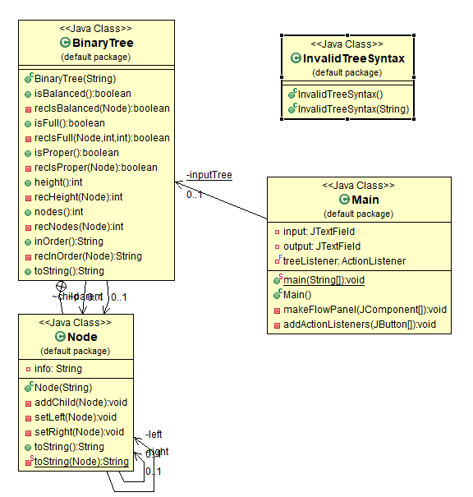
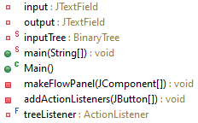
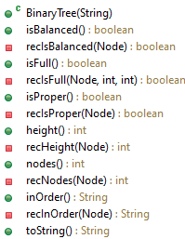
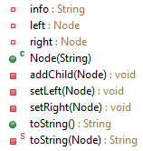

BinaryTree.CLASS
Main.CLASS
Node.CLASS
InvalidTreeSyntax.CLASS

